Slide 1


Hospitality Analysis & Insights
Prepared by:
Ayush, Sanuja, Swathi, Jayshree, Rajan, Priyanshu, Shrusthi

Slide 2

Introduction / Objective
• Analyze hospitality performance: bookings, cancellations, revenue, occupancy, and trends
• Data Sources: Hospitality dataset (cleaned and transformed)
• Aim: Provide insights for decision-making and efficiency improvement

Slide 3




Tools & Approach
• Excel – Data cleaning, pivot tables, utilization %
• Power BI – Interactive dashboards, weekly trends
• Tableau – Advanced visualizations, storytelling
• SQL – Data extraction, queries
This Photo by Unknown Author is licensed under CC BY-SA

Slide 4
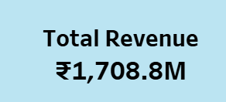
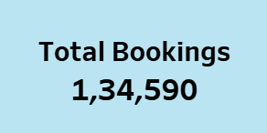
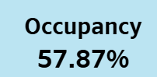
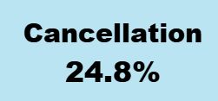
Key KPIs (Hospitality Performance)
Revenue gives us the financial performance.
Total Bookings show customer engagement and demand.
Occupancy % is a measure of efficiency in utilizing available capacity.
Cancellations/no-shows highlight potential revenue loss. Together, these KPIs give a holistic view of the hospitality business performance.”

Slide 5
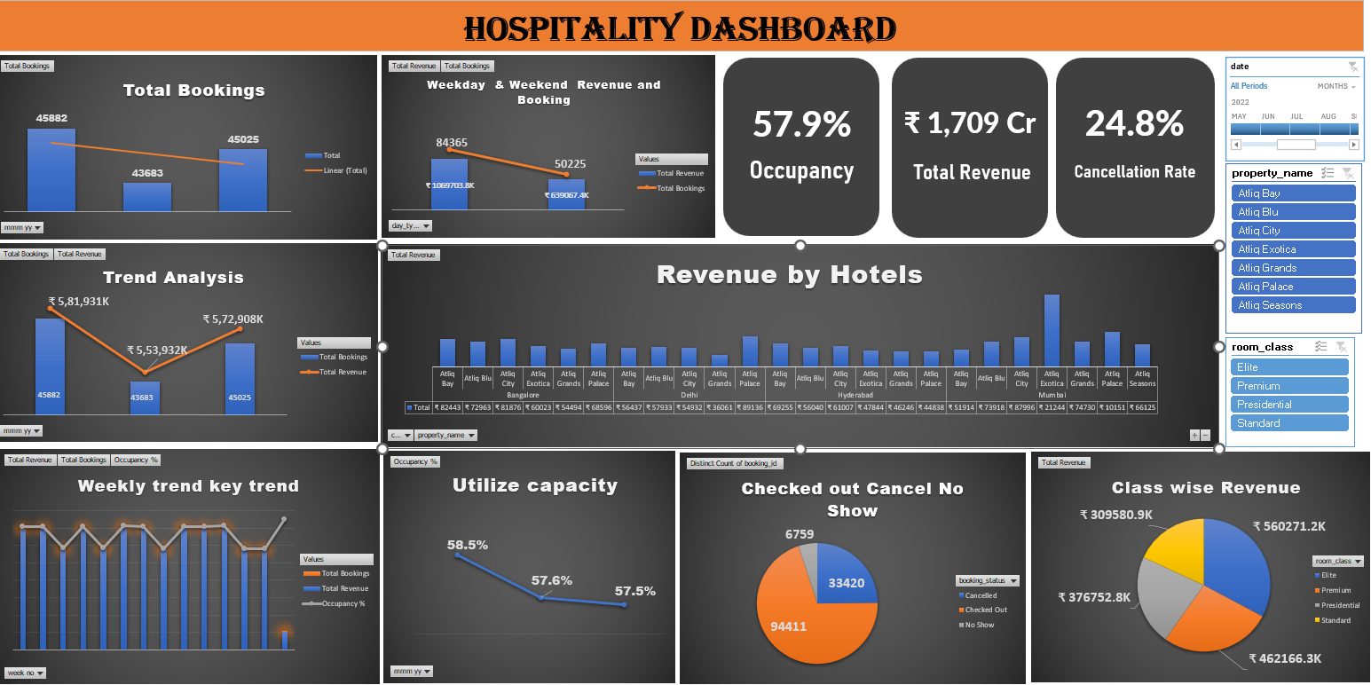
Excel Dashboard

Slide 6
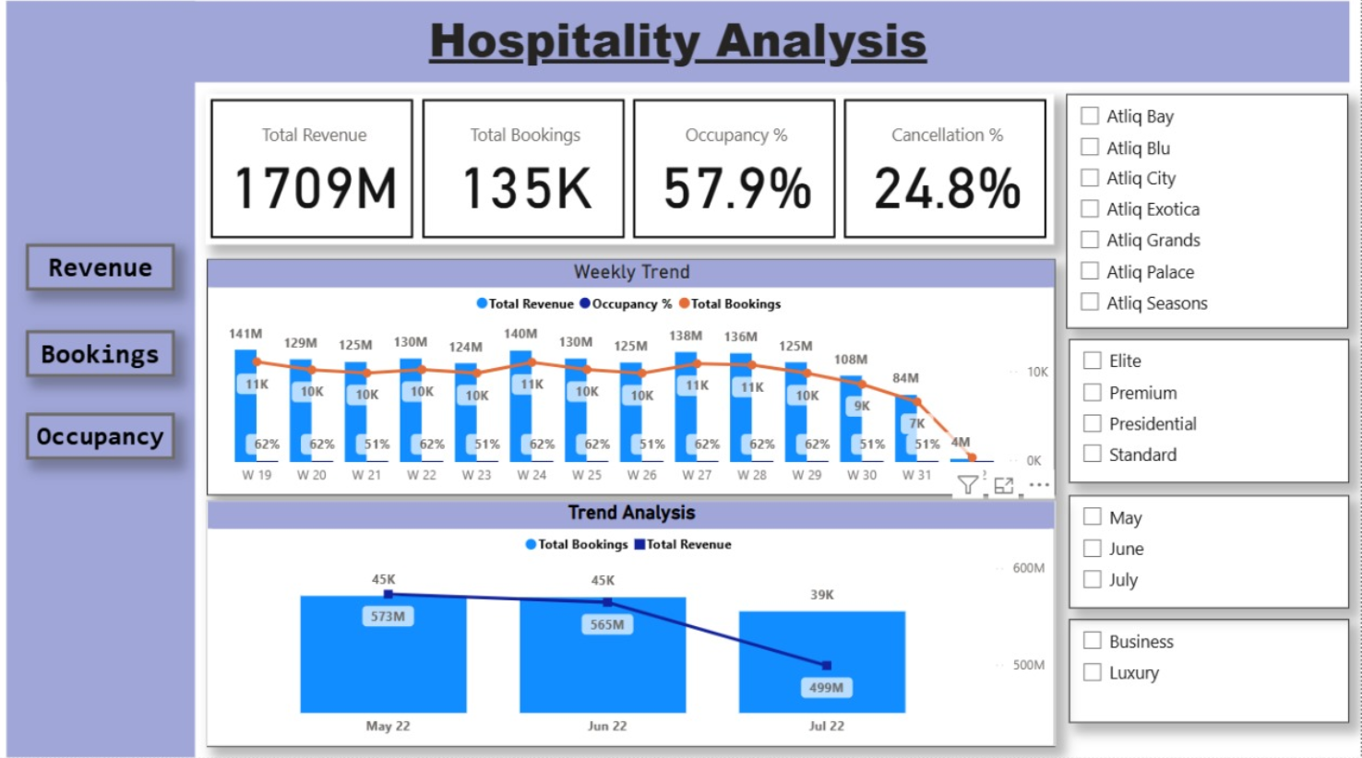
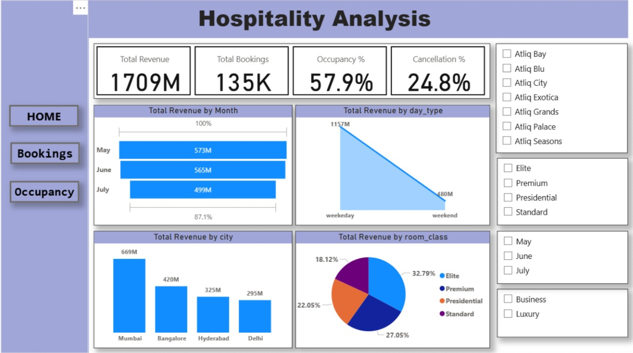
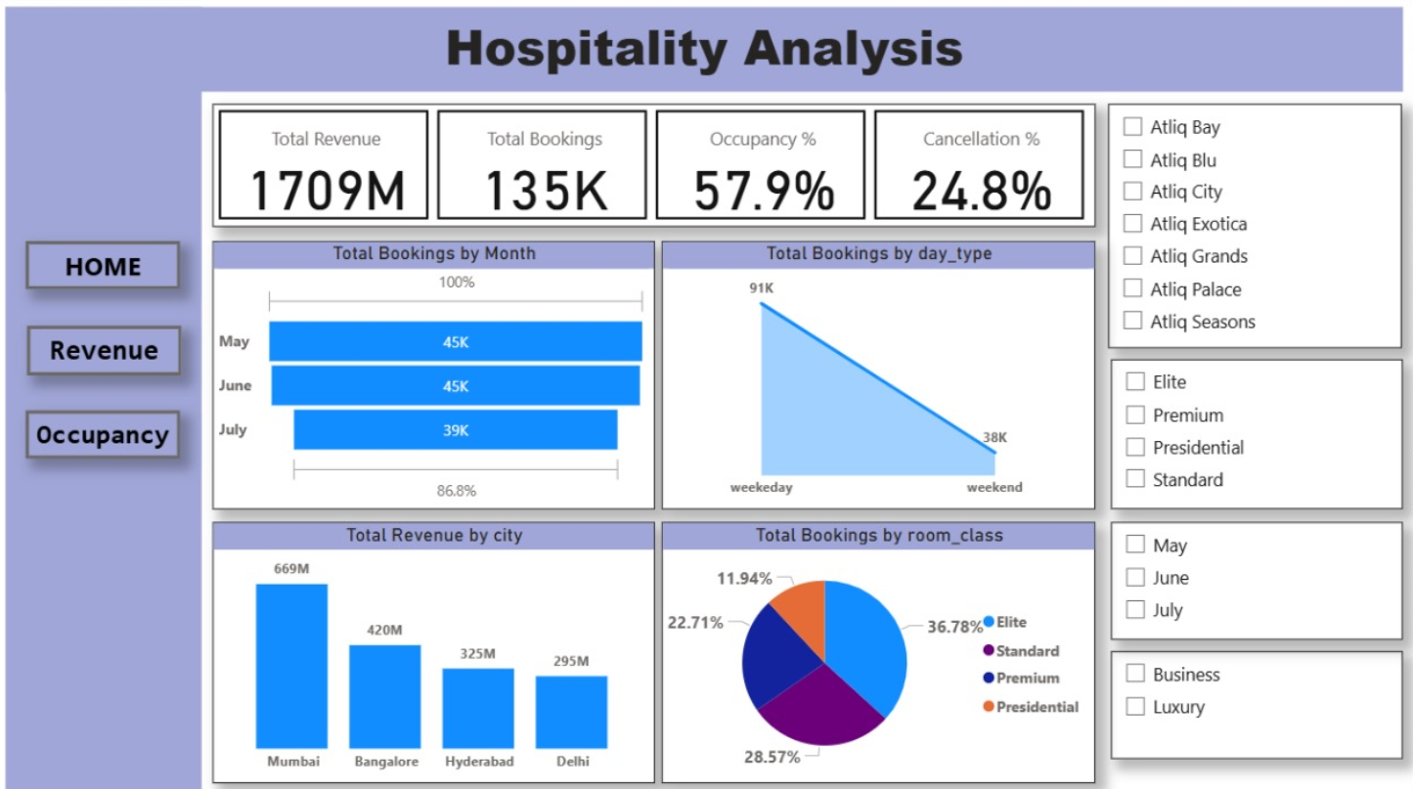
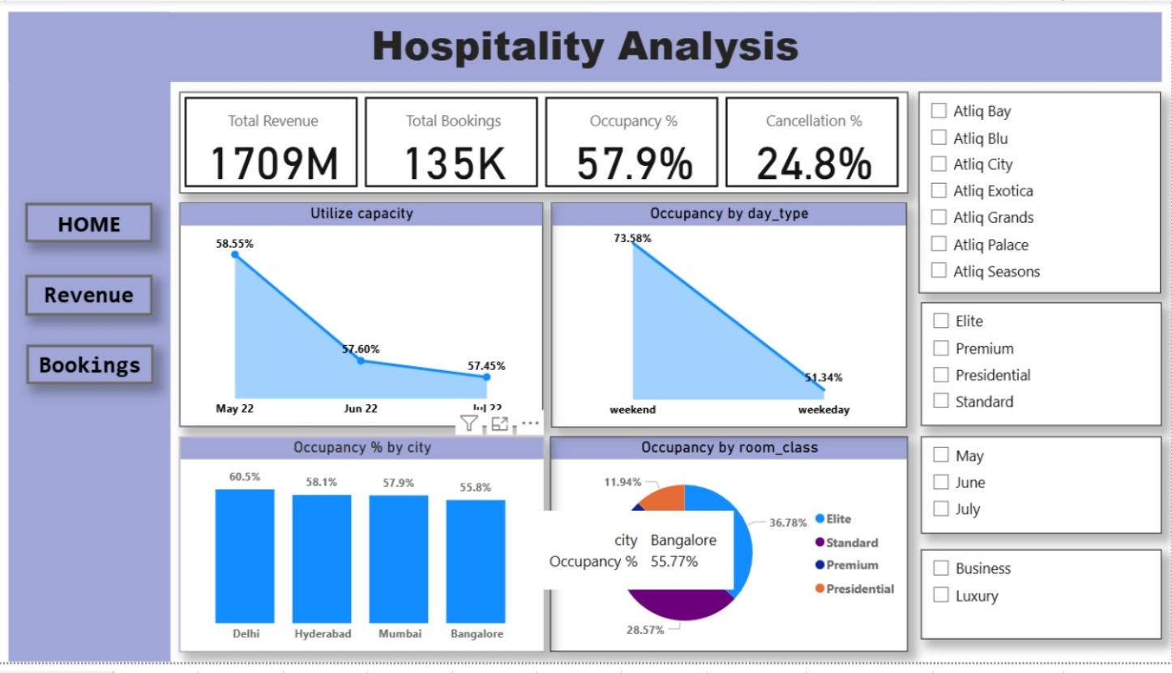
Power BI Dashboard

Slide 7
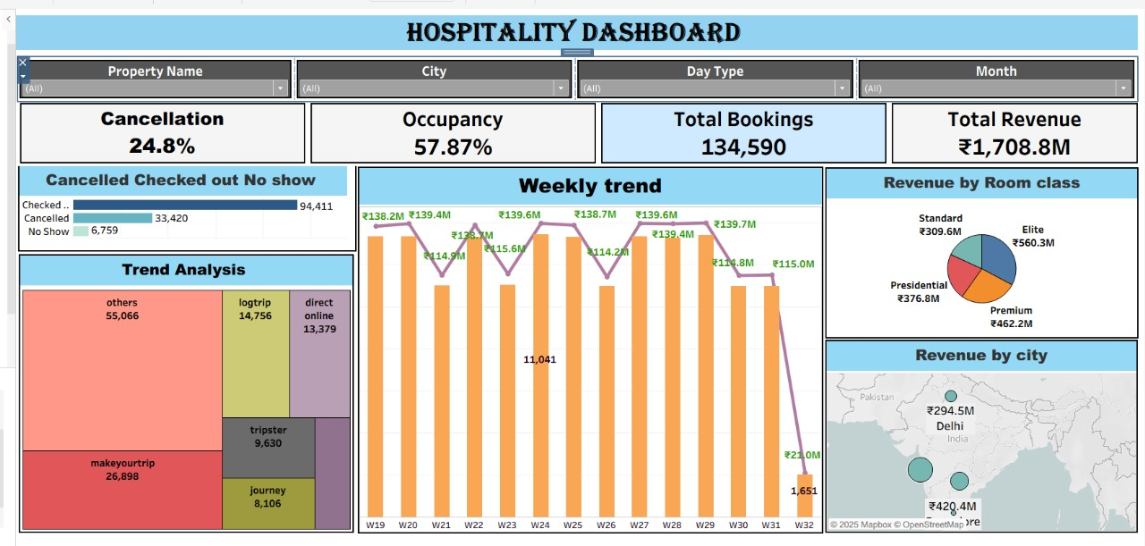
Tableau Dashboard

Slide 8
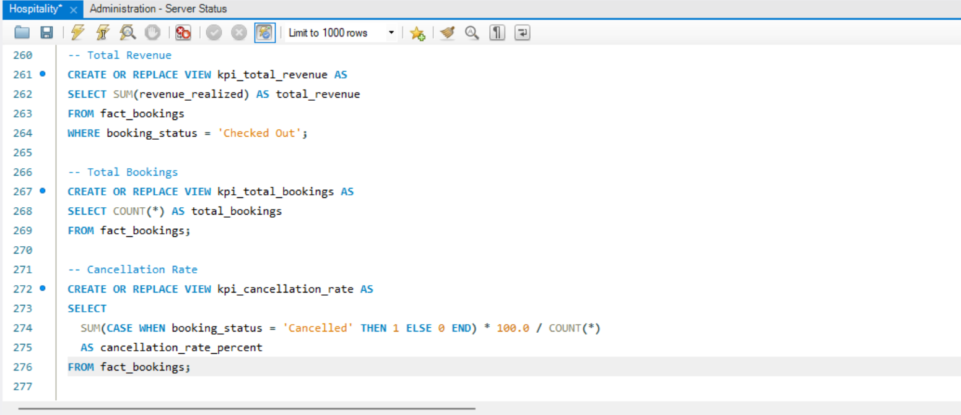
SQL Queries…

Slide 9

Comparative Insights Across Tools
• Excel – Quick calculations and simple reporting
• Power BI – Strong interactivity and connectivity
• Tableau – Advanced visualization and storytelling
• SQL – Reliable backend querying
→ Using multiple tools strengthened the overall analysis

Slide 10

Key Findings
• Utilization rate ~58% (scope for improvement)
• High cancellations/no-shows reduced revenue
• Seasonal occupancy and booking trends identified

Slide 11
Conclusion & Recommendations
• Improve utilization through targeted offers
• Reduce cancellations with stricter booking policies
• Plan resources based on seasonal demand

Slide 12
THANK YOU

